Slide 1



Lecture 2c
Loss Functions
Master in Big Data Solutions 2020-2021 - Artificial Intelligence
Xavier Giró
xavier.giro@bts.tech

Slide 2




Acknowledgements
Kevin McGuinness
kevin.mcguinness@dcu.ie
Research Fellow
Insight Centre for Data Analytics
Dublin City University
Javier Ruiz
javier.ruiz@upc.edu
Associate Professor
ETSETB TelecomBCN
Universitat Politècnica de Catalunya

Slide 3

Motivation

Slide 4
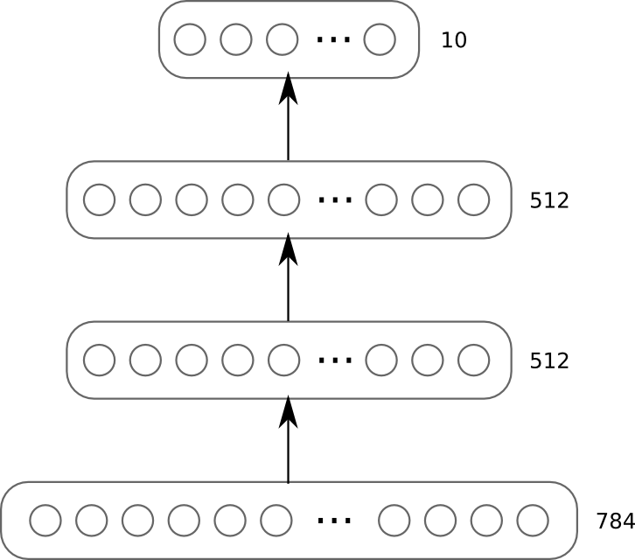
Motivation

Slide 5
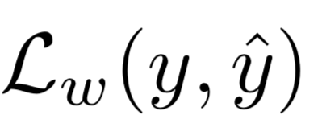
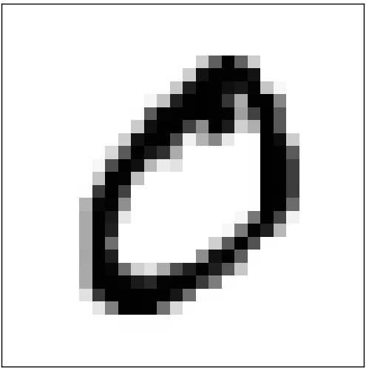
Motivation
y
ŷ
28
28

Slide 6
Outline
Introduction
Definition, properties, training process
Common types of loss functions
Regression
Classification
Ranking
Regularization

Slide 7
Terminology
loss function
cost function
objective function
error function
=
=
=

Slide 8

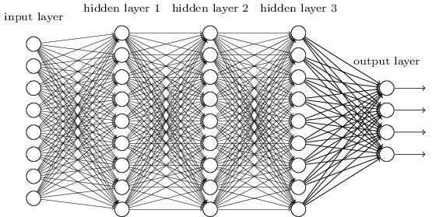
Definition
The loss function measures the quality of a particular set of parameters based on how well the output of the network agrees with the ground truth labels in the training data.
Loss function
“By the tail”
x
Input
f_{θ}(x) = ŷ
Output
y
Label
(ground truth)

Slide 9
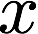
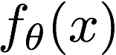
Loss function
How good does our network with the training data?
Deep Neural Network
input
output
labels (ground truth)
input
error
parameters (weights, biases)

Slide 10
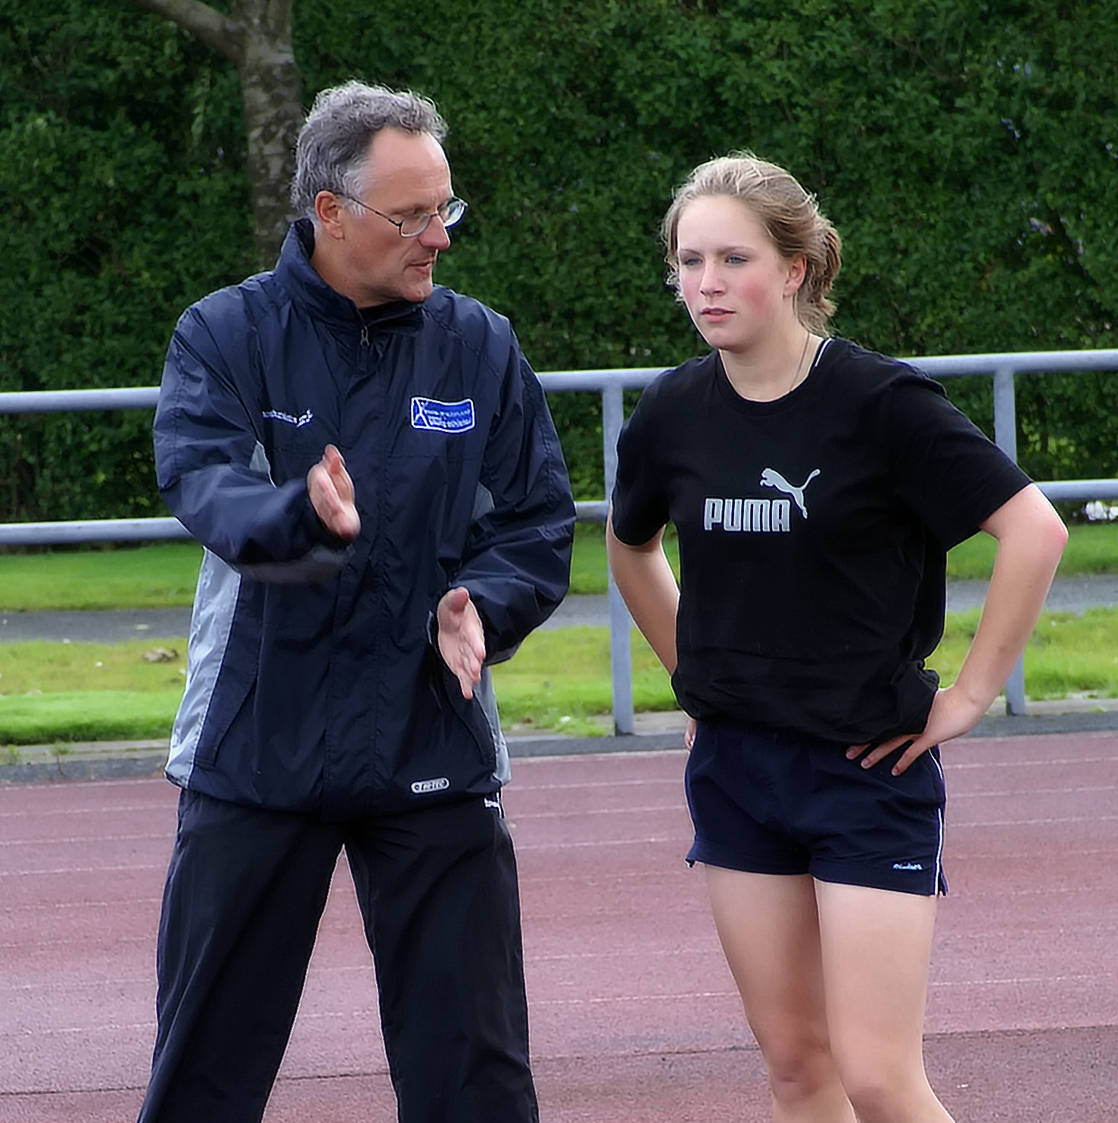
Loss function
The loss function is used to guide the training process in order to find a set of parameters that reduce the value of the loss function.

Slide 11

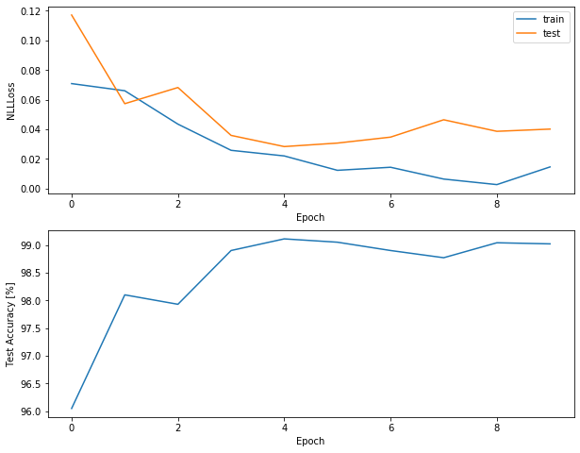

Loss function
The loss function does not necessarily measure the entire performance of the network against a validation/test dataset.
Loss
(eg. NLL)
Evaluation metric
(eg. accuracy)

Slide 12
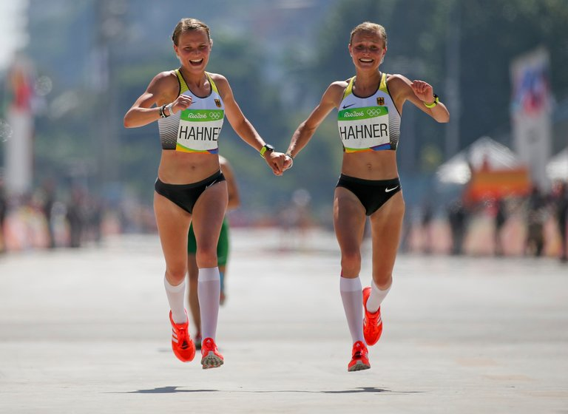
Properties
Minimum (0 value) when the output of the network is equal to the ground truth data.

Slide 13
Properties
Loss function should decrease its value when the neural network output approaches ground truth (GT).
Loss
epoch
Different from GT
Similar to GT

Slide 14
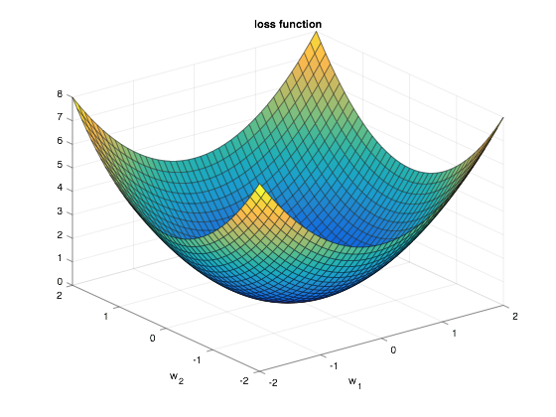
Properties
Ideally → convex function
Notes:
[x y] = meshgrid(-2:0.1:2); z=x.^2+y.^2; surf(x,y,z);
xlabel('w_1'); ylabel('w_2'); title('loss function')

Slide 15
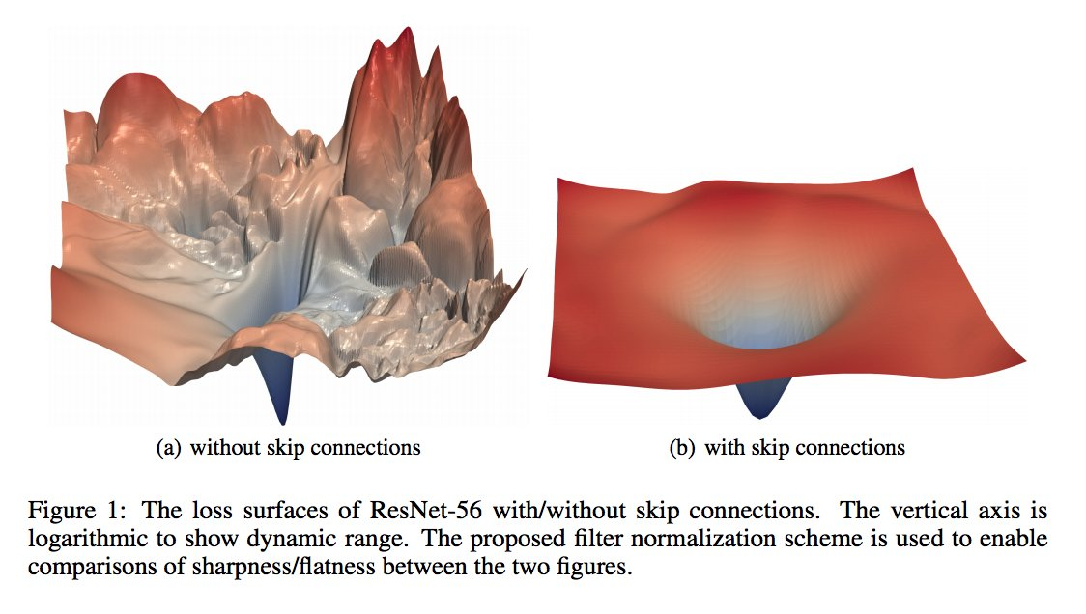

Properties
In reality → some many parameters (in the order of millions) than it is not convex

Slide 16
Properties
….but some neural architectures define more regular loss surfaces.
Li, Hao, Zheng Xu, Gavin Taylor, Christoph Studer, and Tom Goldstein. "Visualizing the loss landscape of neural nets." NeurIPS 2018.
Notes:
[x y] = meshgrid(-2:0.1:2); z=x.^2+y.^2; surf(x,y,z);
xlabel('w_1'); ylabel('w_2'); title('loss function')

Slide 17
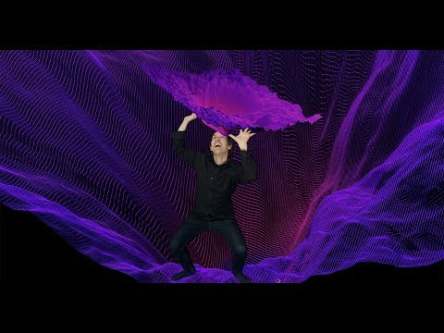
Loss Landscape by Javier Ideami (2019)

Slide 18
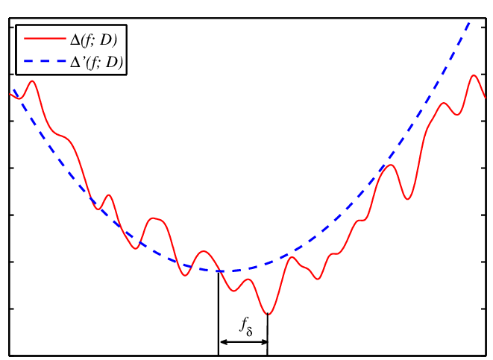

Properties
Hopefully → Varies smoothly with changes on the output
Easier to train with gradient descent (GD).
Easy to compute small changes in the parameters to get an improvement in the loss
Notes:
[x y] = meshgrid(-2:0.1:2); z=x.^2+y.^2; surf(x,y,z);
xlabel('w_1'); ylabel('w_2'); title('loss function')

Slide 19
Outline
Introduction
Definition, properties, training process
Common types of loss functions
Regression
Classification
Ranking
Regularization
Example

Slide 20

Loss functions for regression
Regression: the network predicts continuous, numeric variables
Example: Price of a house
f_{θ}(x) = ŷ = w^{T} · x + b = w1·x1 + w2·x2 + w3·x3 + … + wM·xM + b
Which loss function would you choose for this problem ?

Slide 21
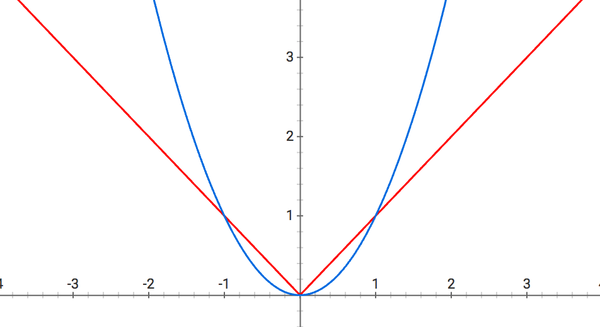
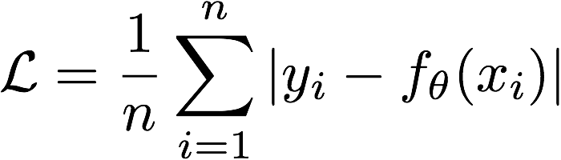
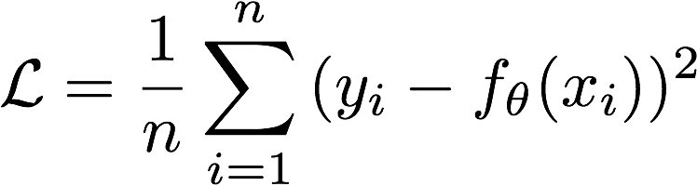
Loss functions for regression
L1 Loss - MAE
L2 Loss - MSE
Which of these two losses is lighter to compute ?
Figure: Amod Kolwalkar, “Regularization in Machine Learning and Deep Learning” (2019)
Notes:
Sparser solutions are good for feature selection in high dimensional spaces, as well for prediction speed.

Slide 22
Loss functions for regression
L1 Loss - MAE
L2 Loss - MSE
Which of these two losses is more sensitive to outliers ( |y_{i}-f_{θ}(x_{i})|>>1) ?
Figure: Amod Kolwalkar, “Regularization in Machine Learning and Deep Learning” (2019)
Notes:
L2 loss is more sensitive to outliers.

Slide 23
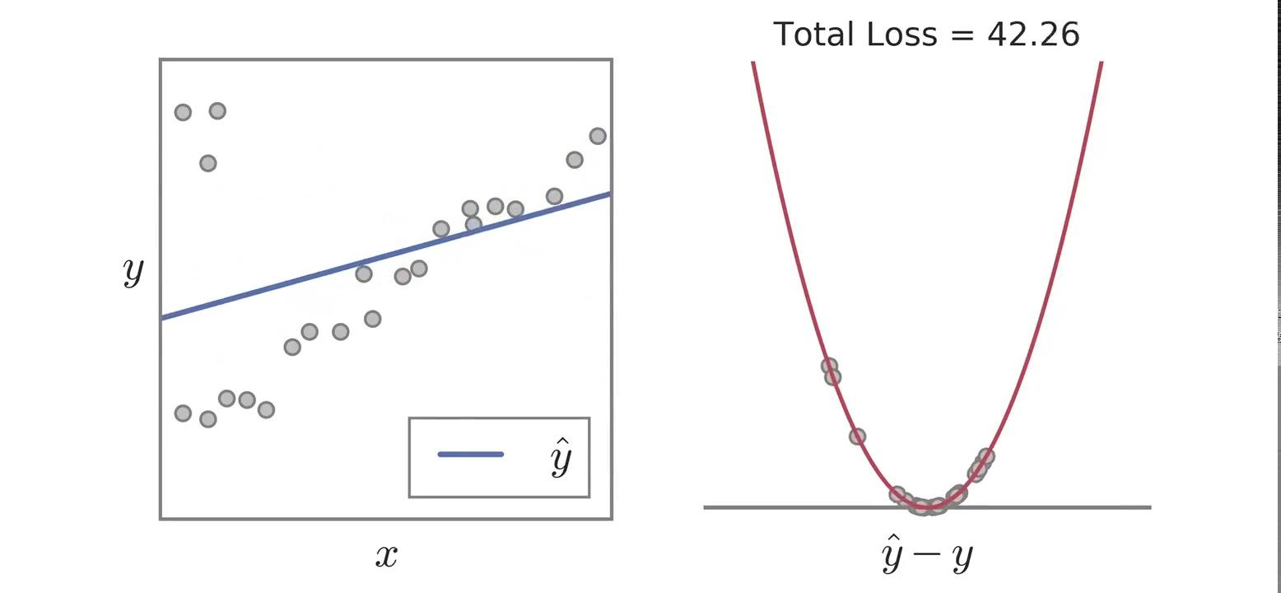
Loss functions for regression
L2 loss (MSE) has more problems when there are outliers in the data
Source: Barron, J. T. A general and adaptive robust loss function. CVPR 2019 [slides] [Tweet by Ankur Handa]

Slide 24
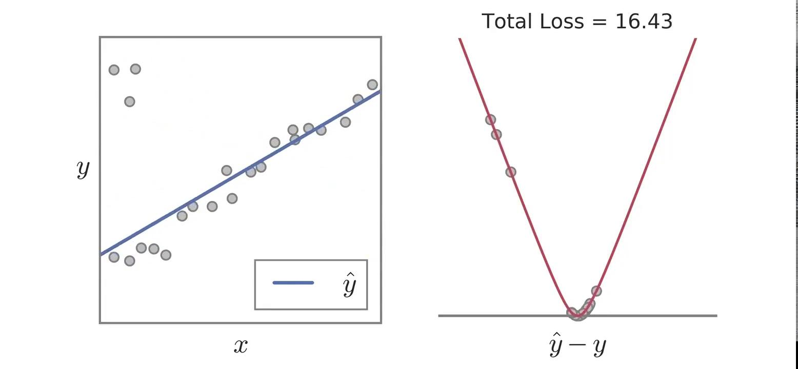
Loss functions for regression
Pseudo-Huber loss (Charbonnier, Smooth L₁) is generally more resilient to outliers than L2.
Source: Barron, J. T. A general and adaptive robust loss function. CVPR 2019 [slides] [Tweet by Ankur Handa]

Slide 25
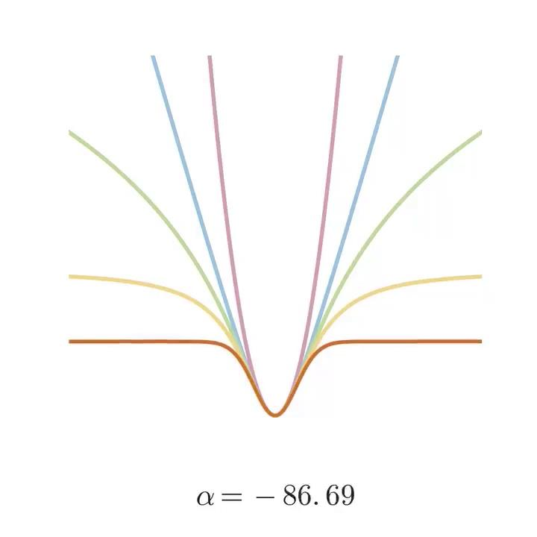
Loss functions for regression
Barron (2019) proposes an analytical function that can represent a family of well known robust cost functions just with a single parameter (alpha).
Alpha lets you walk through L2, huber, cauchy, tukey and more.
Barron, Jonathan T. "A general and adaptive robust loss function." CVPR 2019. [slides] [Tweet by Ankur Handa]

Slide 26
Outline
Introduction
Definition, properties, training process
Common types of loss functions
Regression
Classification
Ranking
Regularization
Example

Slide 27
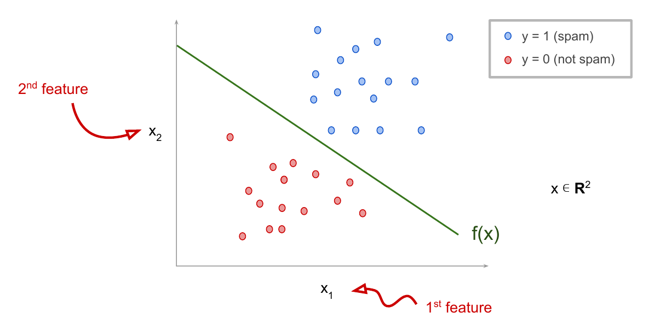

Loss functions for classification
Classification: the network predicts categorical variables (fixed number of classes)
Example: classify email as spam.

Slide 28
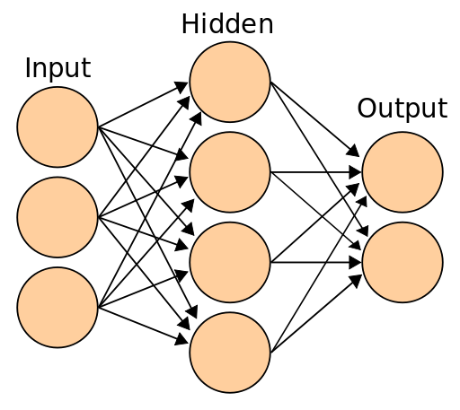
Loss functions for classification
Each input can have only one label
One prediction per output class
The network will have “k” outputs (number of classes)
f_{θ}(x) = ŷ
Network
input
0.1
0.7
1.2
class “1”
class “2”
class “3”
Softmax
output
Class
How should the grount truth labels be encoded ?
Notes:
w

Slide 29
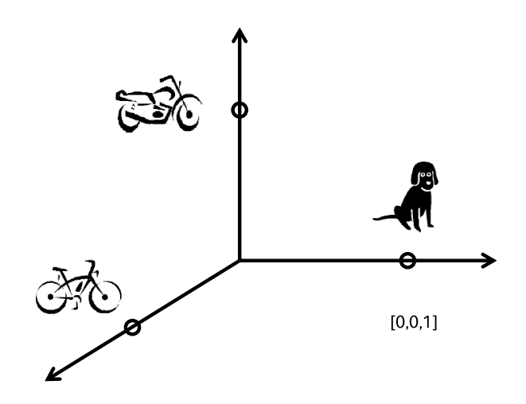
One-hot encoding
[0,1,0]
One-hot representations
[1,0,0]
[0,0,1]
Perronin, F., CVPR Tutorial on LSVR @ CVPR’14, Output embedding for LSVR

Slide 30
One-hot encoding
Transform each GT label into a vector (with only 1 and 0)
Length equal to the total number of classes “k”
Value of 1 for the correct class and 0 elsewhere
class “1”
class “2”
class “3”
1
0
0
0
1
0
0
0
1

Slide 31
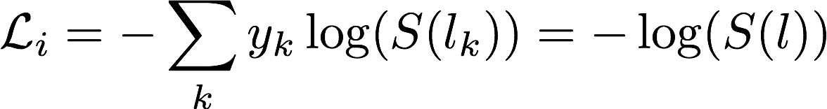
Cross-entropy or Negative Log-Likelihod (NLL)
Logit
l
Softmax output
S(l)
GT Label
y
Network
Input x
0.1
2
1
0.1
0.7
0.2
0
1
0
Loss function
Natural (Napierian) logarithm (ln)

Slide 32
Cross-entropy or Negative Log-Likelihood (NLL)
Logit
l
Softmax output
S(l)
GT Label
y
Network
Input x_{i}
0.1
2
1
0.1
0.7
0.2
0
1
0
Loss function
Loss contribution from sample x_{i} in a training batch

Slide 33
Cross-entropy or Negative Log-Likelihood (NLL)
Logit
l
Softmax output
S(l)
GT Label
y
Network
Input x_{i}
0.1
2
1
0.1
0.7
0.2
0
1
0
Loss function
In a one-hot vector, only one y_{k}=1 (rest are 0) !!

Slide 34
Cross-entropy or Negative Log-Likelihhod (NLL)
Logit
l
Softmax output
S(l)
GT Label
y
Network
Input x_{i}
0.1
2
1
0.1
0.7
0.2
0
1
0
Loss function
Only the softmax output for the GT class is considered.

Slide 35
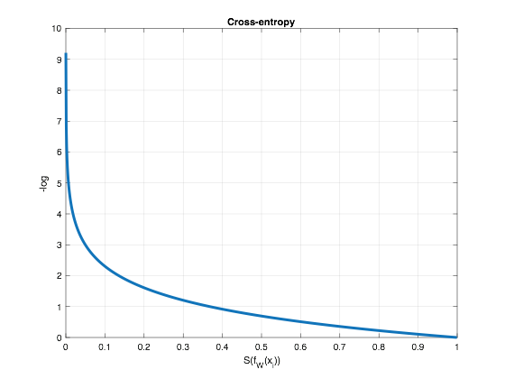
Cross-entropy or Negative Log-Likelihood (NLL)
-log sets high losses for small confidence scores for GT class

Slide 36
Cross-entropy loss vs L2 for Classification
Could we use regression losses (eg. L1, L2) to address a classification task ?
In general, cross-entropy loss works better than L2 loss:
Square error loss usually gives too much emphasis to incorrect outputs.
In square error loss, as the output gets closer to either 0.0 or 1.0 the gradients get smaller, the change in weights gets smaller and training is slower.
Notes:
x = 0.0001:0.001:1; plot(x,-log(x),'LineWidth',3),grid,xlabel('l_i'),ylabel('-log'),title('Cross-entropy')

Slide 37
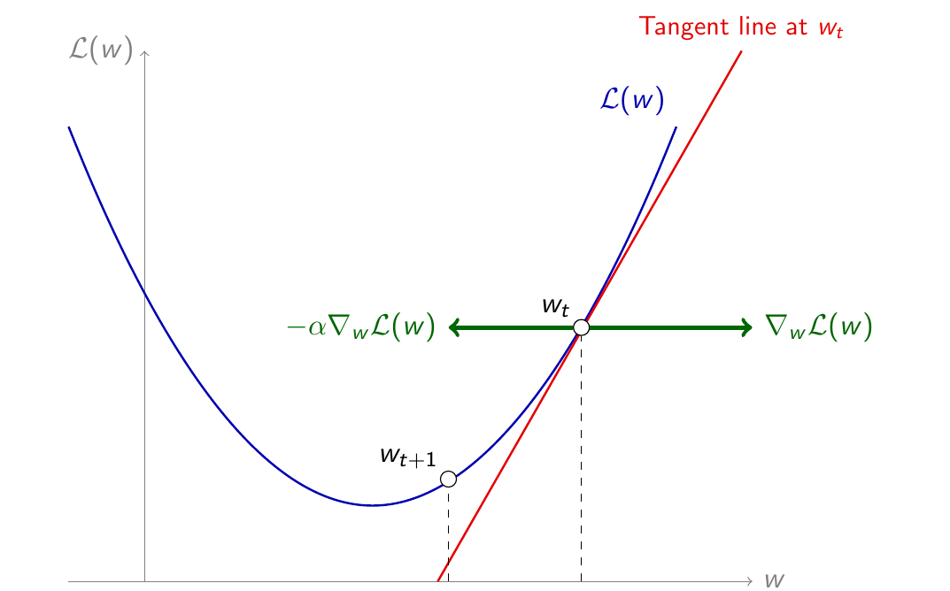
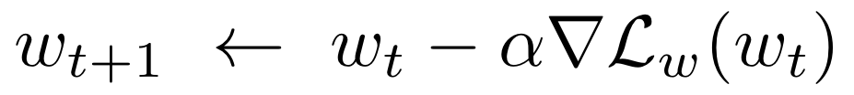
Reminder: Gradient Descent (GD)
Motivation for this lecture:
if we had a way to estimate the gradient of the loss (▽L) with respect to the parameter(s), we could use gradient descent to optimize them.
L_{w}
Descend
(minus sign)
Learning
rate (LR)
Notes:
Canvia la W o la W1

Slide 38
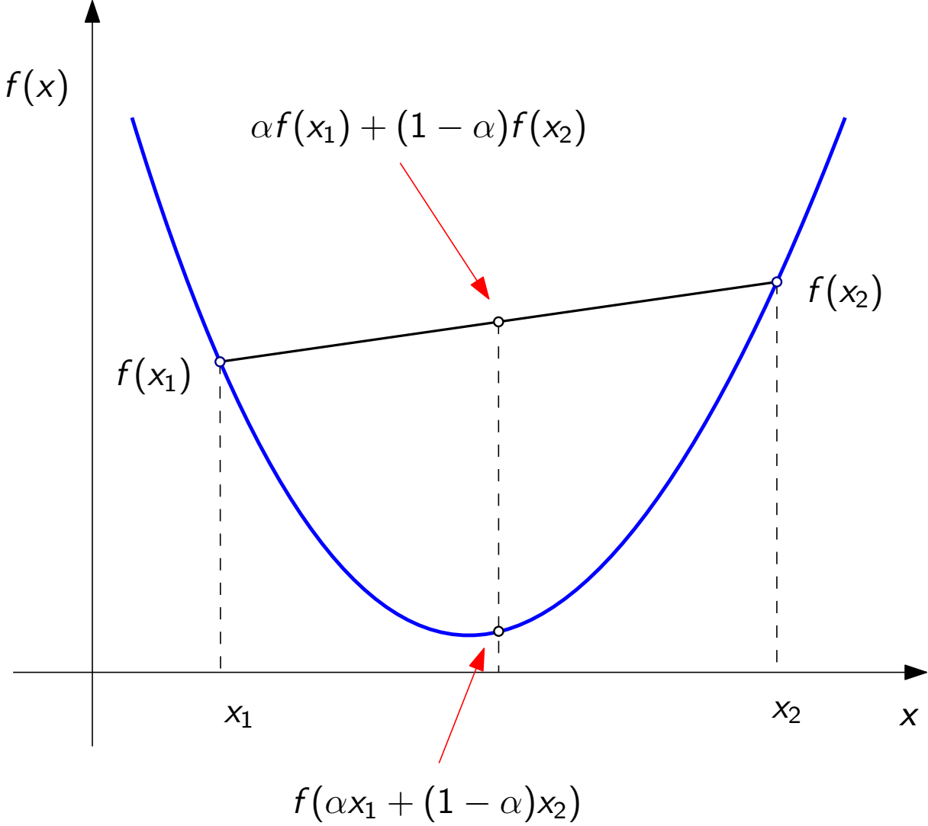
In other courses: Convex optimization
A function is convex if for all α ∈ [0,1]:
Examples
Quadratics
2-norms
Properties
All local minima have same value as the global minimum

Slide 39
Stochastic Gradient Descent (SGD)
SGD: estimate the gradient using a subset of the examples
Pick a single random training example
Estimate a (noisy) loss on this single training example (the stochastic gradient)
Compute gradient wrt. this loss
Take a step of gradient descent using the estimated loss
Slide: Kevin McGuinness (DCU)
Notes:
Canvia la W o la W1

Slide 40
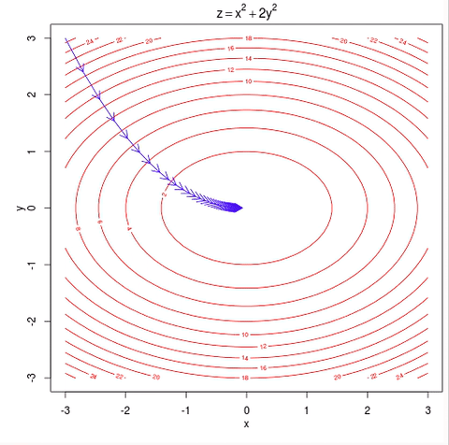
Stochastic Gradient Descent (SGD)
Slide: Kevin McGuinness (DCU)
Notes:
Canvia la W o la W1

Slide 41
Mini-batch Stochastic Gradient Descent (SGD)
SGD Advantages
Very fast (only need to compute gradient on single example)
Memory efficient (does not need the full dataset to compute gradient)
Online (don’t need full dataset at each step)
SGD Disadvantages
Gradient is very noisy, may not always point in correct direction
Convergence can be slower
In practice: Mini-batch SGD
Estimate gradient on small batch of training examples (say 50)
Known as mini-batch stochastic gradient descent
Slide: Kevin McGuinness (DCU)
Notes:
Canvia la W o la W1

Slide 42
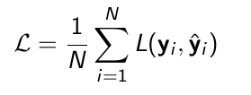
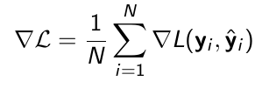
Mini-batch Stochastic Gradient Descent (SGD)
Computing the gradient for the full dataset at each step is slow
Especially if the dataset is large!
For most losses we care about, the total loss can be expressed as a sum (or average) of losses on the individual examples
The gradient is the average of the gradients on individual examples
Slide: Kevin McGuinness (DCU)
Notes:
Canvia la W o la W1

Slide 43
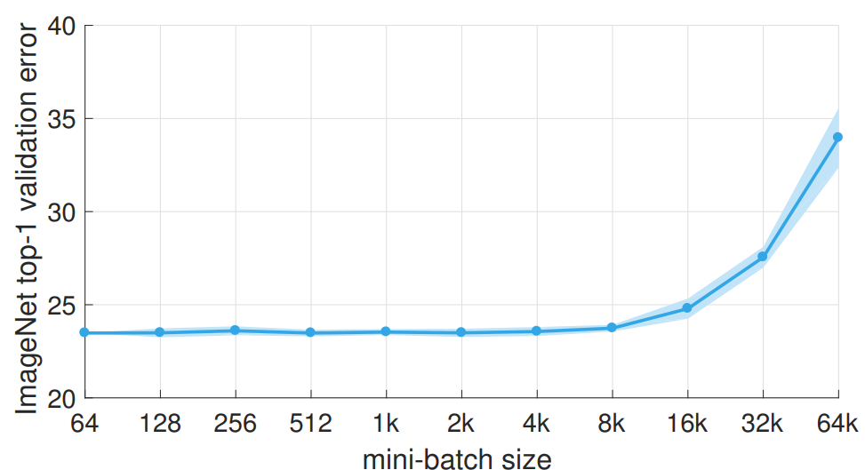
Mini-batch Stochastic Gradient Descent (SGD)
He et al. (original)
Goyal, Priya, Piotr Dollár, Ross Girshick, Pieter Noordhuis, Lukasz Wesolowski, Aapo Kyrola, Andrew Tulloch, Yangqing Jia, and Kaiming He. "Accurate, large minibatch SGD: training imagenet in 1 hour." arXiv preprint arXiv:1706.02677 (2017).
Notes:
Canvia la W o la W1

Slide 44
Cross-entropy or Negative Log-Likelihood (NLL)
Compute the accuracy of the predictions
Compute the cross-entropy loss of the prediction
Softmax Outputs S(l_{i})
Ground Truth
0.3
0.4
0.3
0.1
0.7
0.2
0.1
0.2
0.7
1
0
0
0
1
0
0
0
1
ŷ₁ ŷ₂ ŷ₃
y₁ y₂ y₃
James D. McCaffrey, Why you should use cross-entropy instead of classification error (2016).

Slide 45
Cross-entropy or Negative Log-Likelihood (NLL)
Compute the accuracy of the predictions.
The class with the maximum confidence is predicted.
Softmax Outputs S(l_{i})
Predictions
Ground Truth
0.3
0.4
0.3
0.1
0.7
0.2
0.1
0.2
0.7
0
1
0
0
1
0
0
0
1
1
0
0
0
1
0
0
0
1
ŷ₁ ŷ₂ ŷ₃
y₁ y₂ y₃
James D. McCaffrey, Why you should use cross-entropy instead of classification error (2016).

Slide 46
Cross-entropy or Negative Log-Likelihood (NLL)
Compute the accuracy of the predictions.
Class predictions and ground truth can be compared with a confusion matrix.
 |  | Prediction
 |  | Class 1 | Class 2 | Class 3
GT | Class 1 | 0 | 0 | 1
 | Class 2 | 0 | 1 | 0
 | Class 3 | 0 | 0 | 1
Softmax Outputs S(l_{i})
Predictions
Ground Truth y_{i}
0.3
0.4
0.3
0.1
0.7
0.2
0.1
0.2
0.7
0
1
0
0
1
0
0
0
1
1
0
0
0
1
0
0
0
1
ŷ₁ ŷ₂ ŷ₃
y₁ y₂ y₃
Accuracy =2 / 3 = 0.66
Accuracy =2 / 3 = 0.66

Slide 47
Cross-entropy or Negative Log-Likelihood (NLL)
Compute the accuracy of the predictions
Compute the cross-entropy loss of the prediction
Softmax Outputs S(l_{i})
Ground Truth
0.3
0.4
0.3
0.1
0.7
0.2
0.1
0.2
0.7
1
0
0
0
1
0
0
0
1
ŷ₁ ŷ₂ ŷ₃
y₁ y₂ y₃
James D. McCaffrey, Why you should use cross-entropy instead of classification error (2016).

Slide 48
Cross-entropy or Negative Log-Likelihood (NLL)
Compute the accuracy of the predictions
Compute the cross-entropy loss of the prediction
Softmax Outputs S(l_{i})
Ground Truth
0.3
0.4
0.3
0.1
0.7
0.2
0.1
0.2
0.7
1
0
0
0
1
0
0
0
1
ŷ₁ ŷ₂ ŷ₃
y₁ y₂ y₃
-log
1.20
0.36
0.36
James D. McCaffrey, Why you should use cross-entropy instead of classification error (2016).

Slide 49
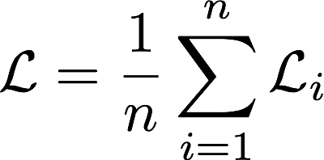
Cross-entropy or Negative Log-Likelihod (NLL)
Compute the accuracy of the predictions
Compute the cross-entropy loss of the prediction
Softmax Outputs S(l_{i})
Ground Truth y_{i}
0.3
0.4
0.3
0.1
0.7
0.2
0.1
0.2
0.7
1
0
0
0
1
0
0
0
1
ŷ₁ ŷ₂ ŷ₃
y₁ y₂ y₃
-log
1.20
0.36
0.36
L= 1.92 / 3 = 0.64
Why you should use cross-entropy instead of classification error

Slide 50
Cross-entropy or Negative Log-Likelihood (NLL)
Compute the accuracy of the predictions
Compute the cross-entropy loss of the prediction
Softmax Outputs S(l_{i})
Ground Truth y_{i}
0.3
0.4
0.3
0.1
0.7
0.2
0.1
0.2
0.7
1
0
0
0
1
0
0
0
1
ŷ₁ ŷ₂ ŷ₃
y₁ y₂ y₃
-log
1.20
0.36
0.36
Classification accuracy = 0.66
cross-entropy loss = 0.64
L=0.64
Why you should use cross-entropy instead of classification error

Slide 51
Cross-entropy or Negative Log-Likelihood (NLL)
c) Compare the result of batch A & batch B, and discuss how accuracy and cross-entropy have captured the quality of the predictions.
Training Batch A
Trainning Batch B
S(l_{i})
S(l_{i})
Ground Truth y_{i}
0.3
0.4
0.3
0.1
0.7
0.2
0.1
0.2
0.7
1
0
0
0
1
0
0.1
0.2
0.7
0
0
1
0.3
0.4
0.3
0.3
0.3
0.4
ŷ₁ ŷ₂ ŷ₃
ŷ₁ ŷ₂ ŷ₃
y₁ y₂ y₃
Accuracy =2 / 3 = 0.66
Cross-entropy=0.64
Accuracy =2 / 3 = 0.66
Cross-entropy=1.37

Slide 52
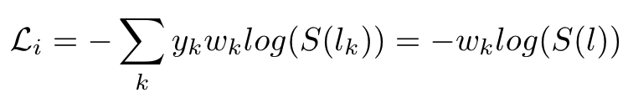
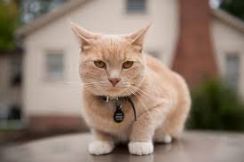
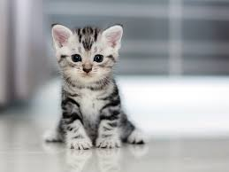
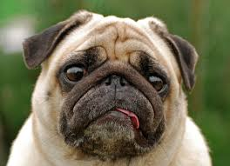
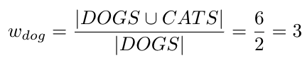

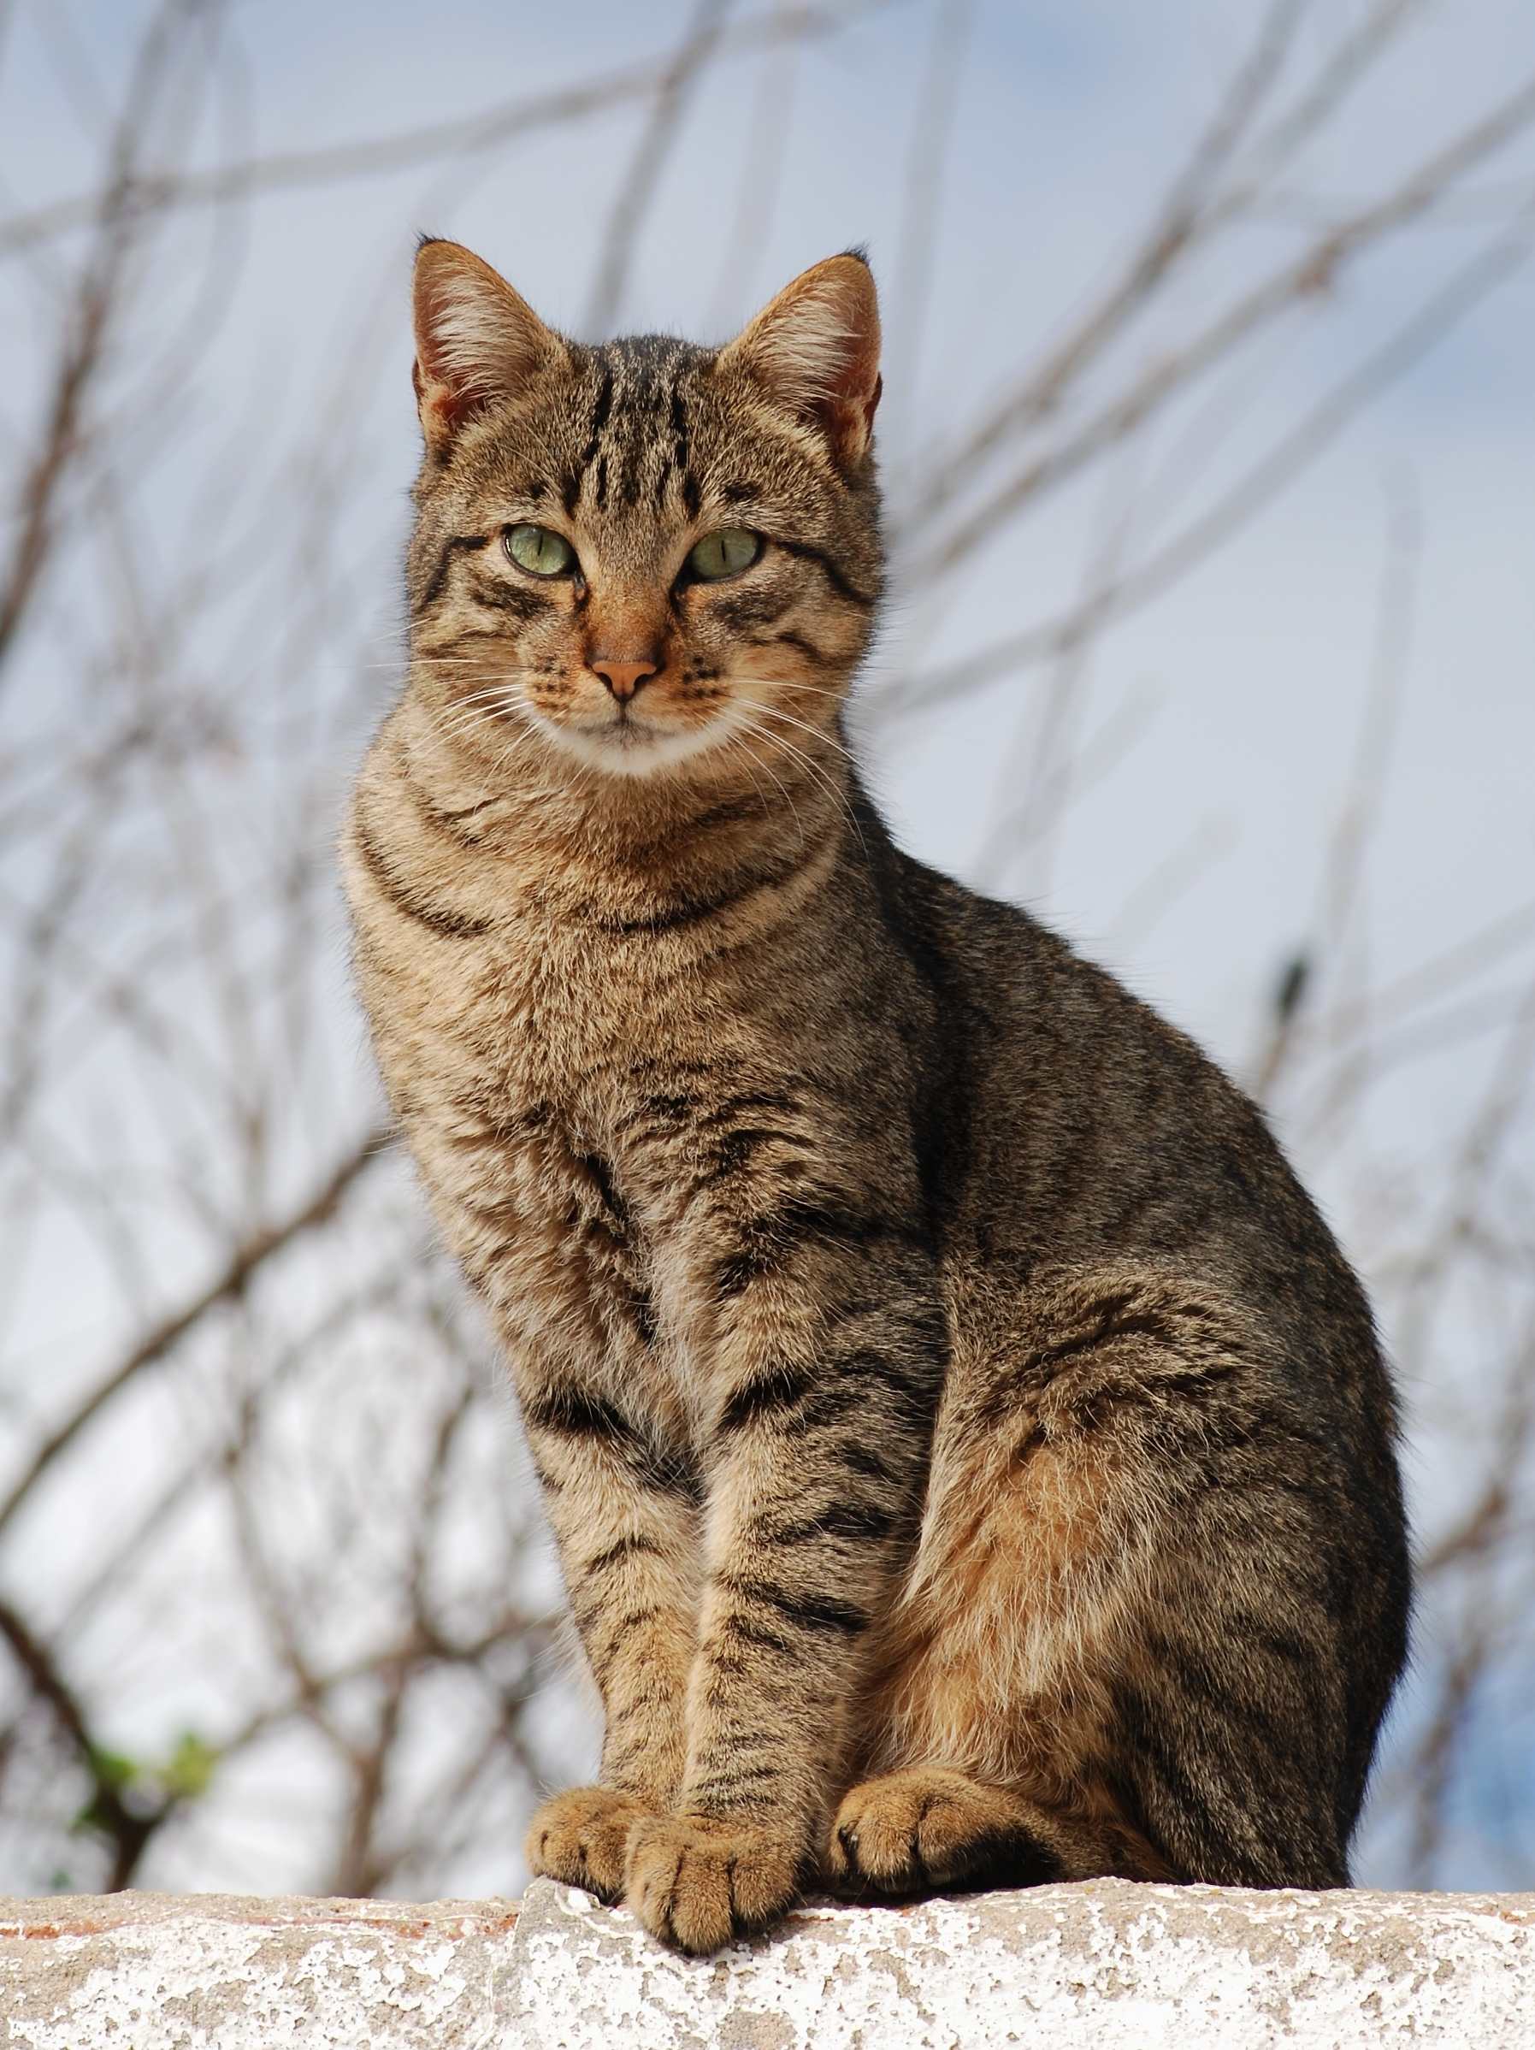

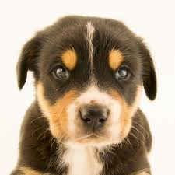
Weighted Cross-entropy loss
In case of class imbalance in the datasets, loss terms may be weighted (w_{k}), typically by the inverse frequency of the class.

Slide 53
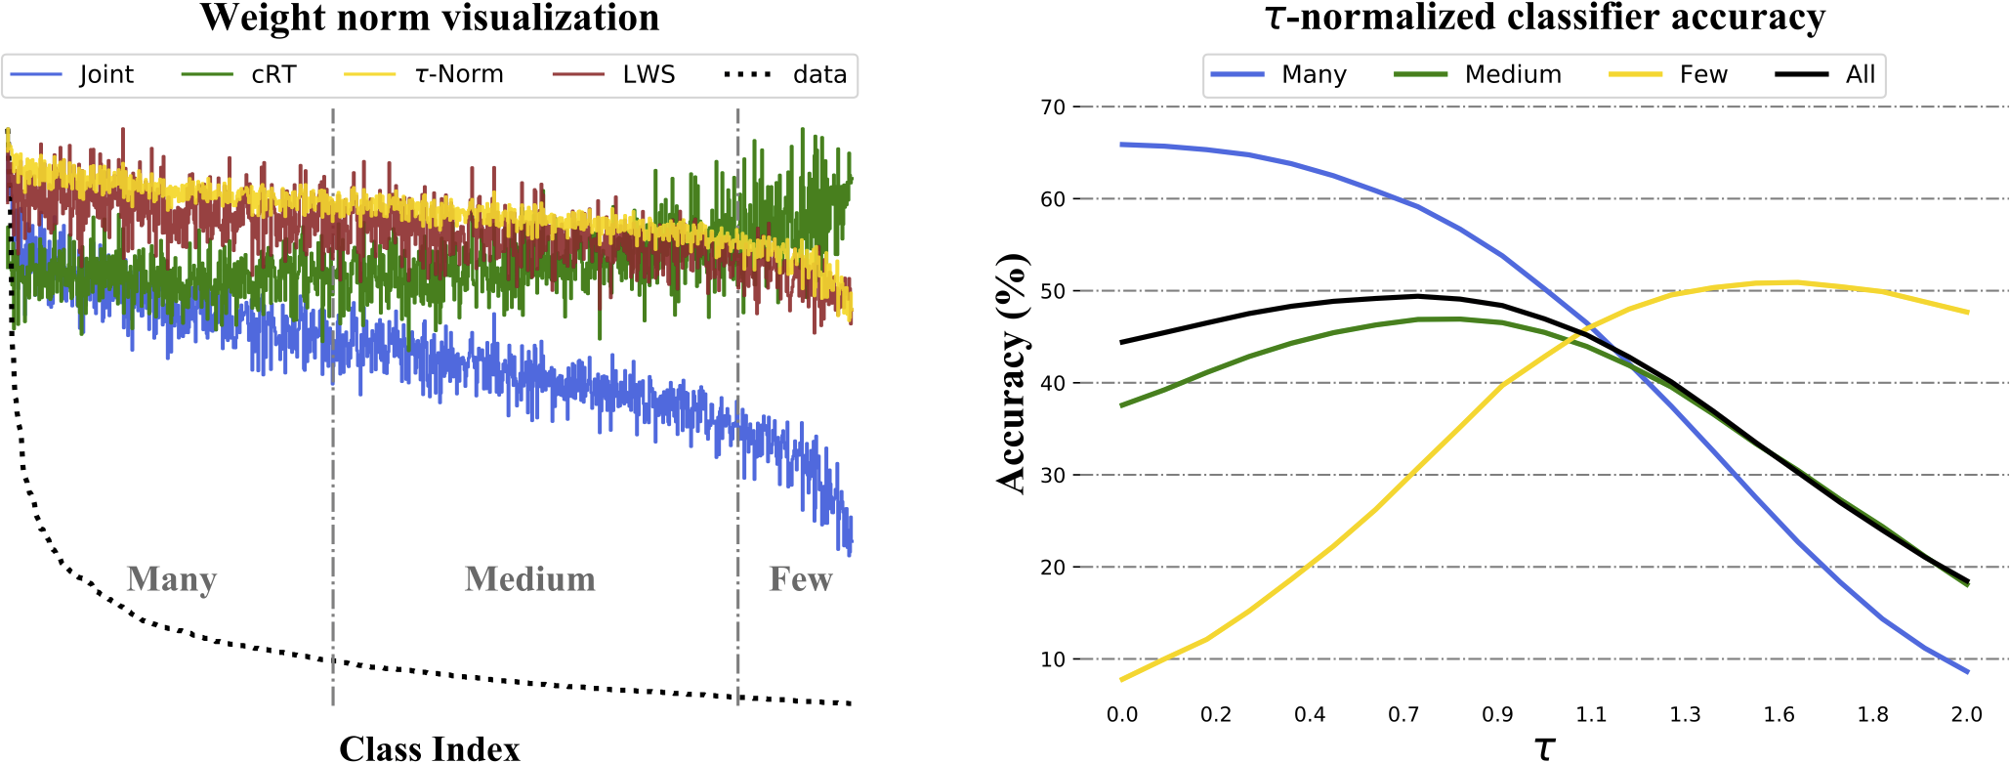
Weighted Cross-entropy loss
Kang, B., Xie, S., Rohrbach, M., Yan, Z., Gordo, A., Feng, J., & Kalantidis, Y. Decoupling representation and classifier for long-tailed recognition. ICLR 2020.

Slide 54
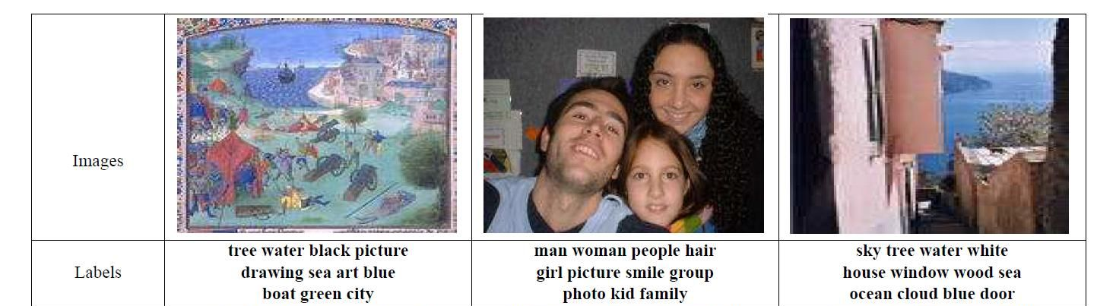
Multi-label classification
If outputs can be matched to more than one label...
“car”, “automobile”, “motor vehicle” can be applied to a same image of a car.
Bucak, Serhat Selcuk, Rong Jin, and Anil K. Jain. "Multi-label learning with incomplete class assignments." CVPR 2011.
Notes:
x = -10:0.01:10;plot(x,1./(1+exp(-x)),'LineWidth',3),grid,xlabel('x'),ylabel('1/(1+e^{-x})'),title('Sigmoid');

Slide 55
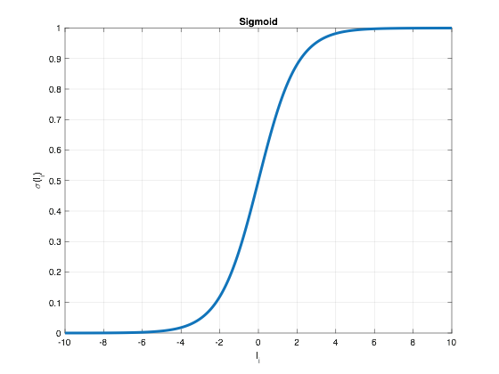
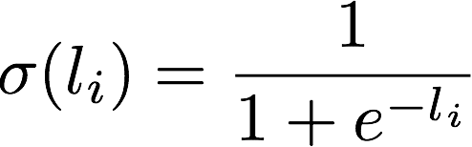
Multi-label classification (1)
If outputs can be matched to more than one label...
“car”, “automobile”, “motor vehicle” can be applied to a same image of a car.
...directly use sigmoid at each output independently instead of softmax.
Notes:
x = -10:0.01:10;plot(x,1./(1+exp(-x)),'LineWidth',3),grid,xlabel('x'),ylabel('1/(1+e^{-x})'),title('Sigmoid');

Slide 56
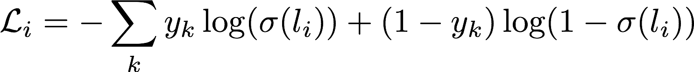
Multi-label classification (2)
Cross-entropy loss for multi-label classification:
Binary switch
Notes:
x = 0.0001:0.001:1; plot(x,-log(x),'LineWidth',3),grid,xlabel('l_i'),ylabel('-log'),title('Cross-entropy')

Slide 57
Multi-label classification (2)
Cross-entropy loss for multi-label classification:
Low loss for a large logit for the GT class….
...or low loss for a small logits for each other non-GT class
Notes:
x = 0.0001:0.001:1; plot(x,-log(x),'LineWidth',3),grid,xlabel('l_i'),ylabel('-log'),title('Cross-entropy')

Slide 58
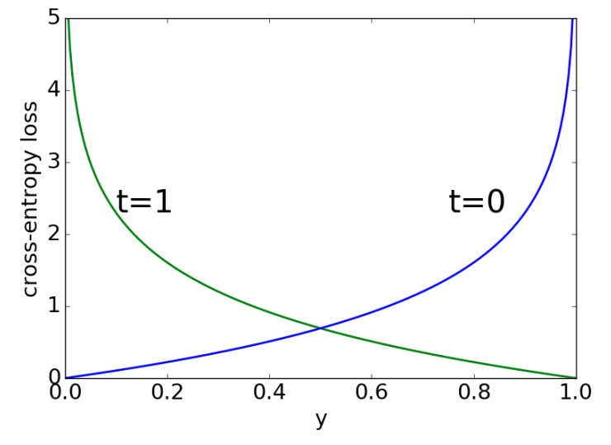
Binary Cross-Entropy loss (BCE)
Specific case of two classes: binary.
Figure: Roger Grosse, “CSC321 L4: Learning a classifier”, University of Toronto (UoT)

Slide 59
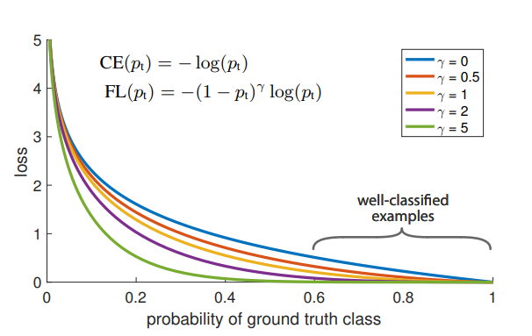
Focal Loss
#FocalLoss Lin, Tsung-Yi, Priya Goyal, Ross Girshick, Kaiming He, and Piotr Dollár. "Focal loss for dense object detection." ICCV 2017 [talk]

Slide 60
Outline
Introduction
Definition, properties, training process
Common types of loss functions
Regression
Classification
Ranking
Regularization

Slide 61
Metric learning
Ranking losses aim at predicting the relative distance (or similarity) between samples.
x₁
d(x₁,x₂)
x₂

Slide 62
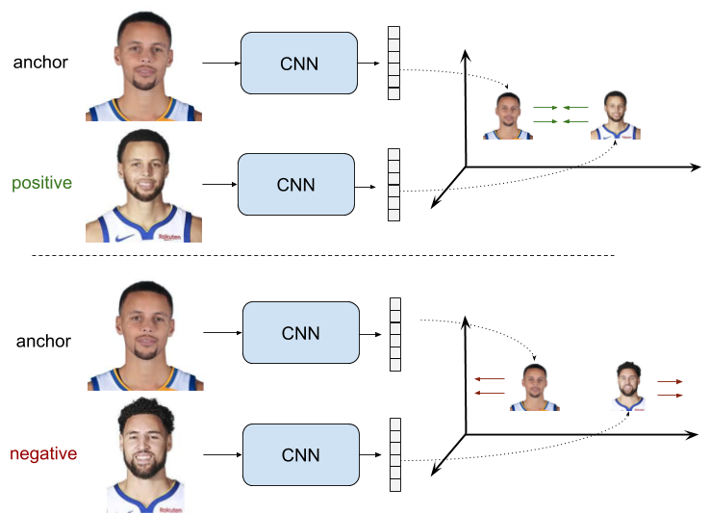
Pairwise Ranking Loss
Source: Raul Gómez, “Understanding Ranking Loss, Contrastive Loss, Margin Loss, Triplet Loss, Hinge Loss and all those confusing names” (2019)
Notes:
Esquema de siamese

Slide 63
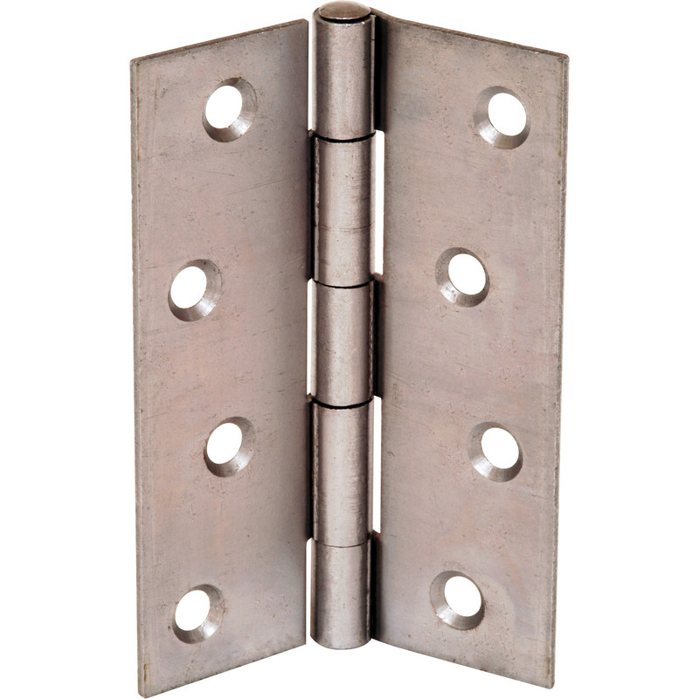
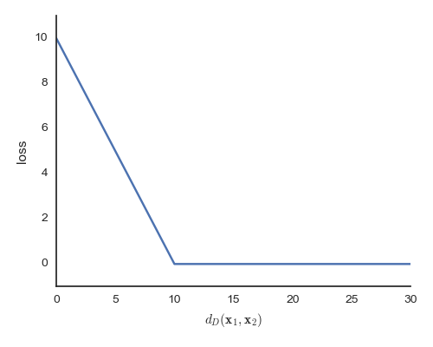
Hinge or margin-based loss
Only negative (N) pairs (x1,x2) closer than a margin m contribute to the penalty.
Hinge loss
Intuition: there is nothing new to learn from those easy negative pairs which are already far enough.
Margin: m
A hinge

Slide 64
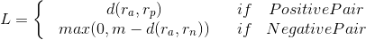
Pairwise Ranking Loss
Hinge loss
Only those hard negative pairs (r_{a},r_{n}) closer than the margin (m) will contribute to the training.
The expression could be formulated considering pairs (r₀,r₁), and y as a binary flag (0,1) as:
Source: Raul Gómez, “Understanding Ranking Loss, Contrastive Loss, Margin Loss, Triplet Loss, Hinge Loss and all those confusing names” (2019)
Notes:
Esquema de siamese

Slide 65

Triplet Ranking Loss
Source: Raul Gómez, “Understanding Ranking Loss, Contrastive Loss, Margin Loss, Triplet Loss, Hinge Loss and all those confusing names” (2019)
Notes:
Esquema de siamese

Slide 66

Triplet Ranking Loss
Relative distance
Only those triplets (r_{a},r_{p},r_{n}) where…
negative is closer to the anchor than the positive [ d(r_{a},r_{p}) - d(r_{a},r_{n}) > 0 ] , or
relative distances are not apart enough [ d(r_{a},r_{n}) - d(r_{a},r_{p}) < m ]
....will contribute to the training.
Example of learning from a wrongly labeled triplet
#FaceNet Schroff, Florian, Dmitry Kalenichenko, and James Philbin. "Facenet: A unified embedding for face recognition and clustering." CVPR 2015.
Notes:
Esquema de siamese

Slide 67

Siamese Networks
Siamese Networks are two identical DNN that share their weights.
Notes:
Esquema de siamese

Slide 68



Three-stream Siamese (Triplet) Networks
a
p
n
CNN
w
CNN
w
CNN
L2 embedding space
Triplet Loss
#FaceNet Schroff, Florian, Dmitry Kalenichenko, and James Philbin. "Facenet: A unified embedding for face recognition and clustering." CVPR 2015.

Slide 69

Implementation
Regression
MSELoss
SmoothL1Loss
L1Loss
Classification
BCELoss (binary case)
NLLLoss
CrossEntropyLoss (Softmax Layer + ) NLL
Ranking
MultiMarginLoss
TripletMarginLoss

Slide 70
Outline
Introduction
Definition, properties, training process
Common types of loss functions
Regression
Classification
Ranking
Regularization Losses

Slide 71

Regularization Losses
Control the capacity of the network to prevent overfitting
L2-regularization (weight decay):
The L2 regularization has the intuitive interpretation of heavily penalizing peaky weight vectors and preferring diffuse weight vectors.
regularization hyperparameter

Slide 72

Regularization Losses
Control the capacity of the network to prevent overfitting
L1-regularization:
The L1 regularization has the intriguing property that it leads the weight vectors to become sparse during optimization (i.e. very close to exactly zero).
regularization hyperparameter

Slide 73

Regularization Losses

Slide 74


Regularization Losses: Label Smoothing
Extracted from paperswithcode.
Figure: Müller, R., Kornblith, S., & Hinton, G. E. (2019). When does label smoothing help?. NeurIPS 2019.

Slide 75


Regularization Losses: Label Smoothing
Source: @remykaren
Jeremy Howard, Implementation in PyTorch
Szegedy, C., Vanhoucke, V., Ioffe, S., Shlens, J., & Wojna, Z. (2016). Rethinking the inception architecture for computer vision. CVPR 2016.
Müller, R., Kornblith, S., & Hinton, G. E. (2019). When does label smoothing help?. NeurIPS 2019.

Slide 76
Outline
Introduction
Definition, properties, training process
Common types of loss functions
Regression
Classification
Regularization

Slide 77
More popular losses in DNN
Kullback–Leibler (KL) divergence [visualization]
Contrastive loss
Hadsell, R., Chopra, S., & LeCun, Y. (2006, June). Dimensionality reduction by learning an invariant mapping. CVPR 2006.
https://ankeshanand.com/blog/2020/01/26/contrative-self-supervised-learning.html
https://twitter.com/phillip_isola/status/1253514436482142209?s=21
Superloss (NeurIPS 2020)
Reformulation of a regression problem as a classification one:
Beckham, C., & Pal, C. (2016). A simple squared-error reformulation for ordinal classification. NIPS ML4H 2016.
Lin et al. Focal Loss for Dense Object Detection. ICCV 2017

Slide 78


